Slide 1
ARM 2022 Changes

Slide 2
Study Rules
ARM Powered by GDM Solutions

Slide 3
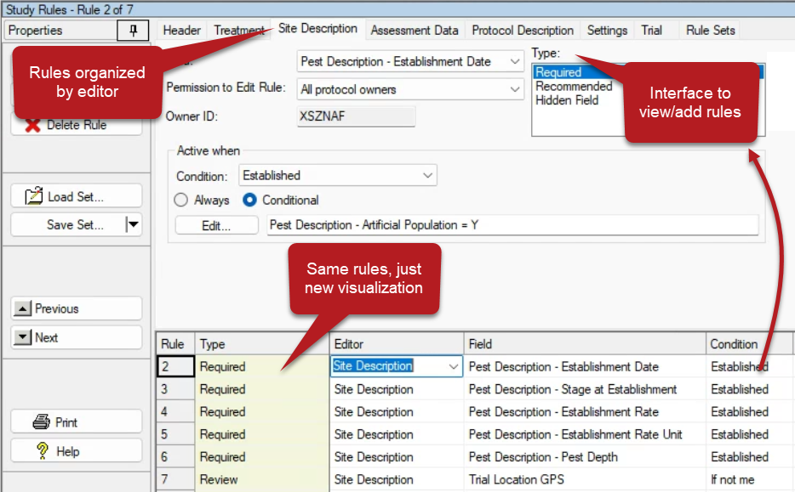
New Interface
1 of 3
2022.7
Notes:
New interface added to the Study Rules editor, to view/add rules.
Same rules are available, just a new visualization, organized by editor.
#W92

Slide 4
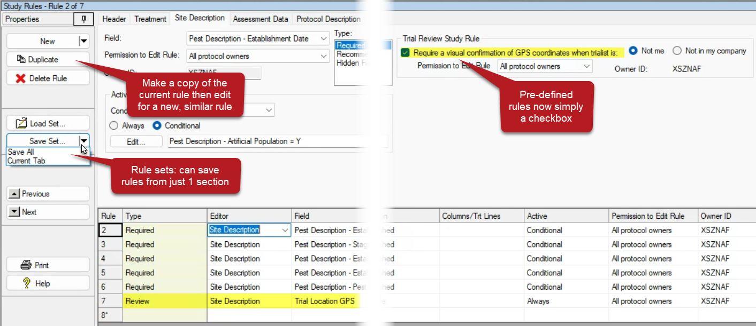
New Interface
2 of 3
2022.7
Notes:
New functions added:
Duplicate button – make a copy of the current rule then editor for a new, similar rule
Rule Sets – can save rules from just 1 section/editor
“Pre-defined” rules are now simply a checkbox to turn on/off in a study
#W92

Slide 5
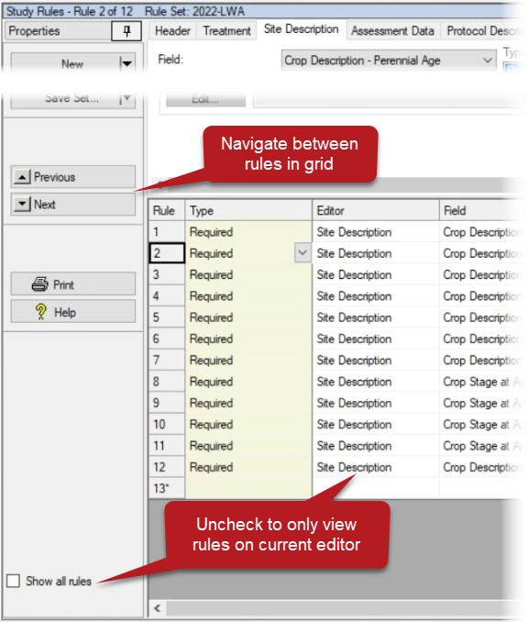
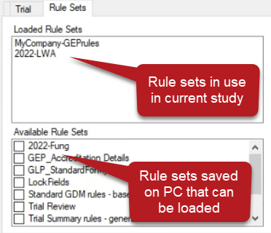
New Interface
3 of 3
2022.7
Notes:
New functions added:
Rule sets tab: view rule sets that have loaded in the current study, and to add more rule sets easily.
Navigate between rules in grid with Next and Previous buttons
Turn off :Show all rules” checkbox to only view rules on the current editor.
#W92

Slide 6
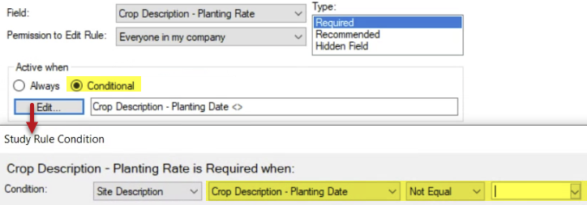
Conditional Rules
Define when a study rule should be activated, based on another field’s contents
E.g. Require Crop Planting Rate, only when Planting Date is filled in
Boost your company’s “global rule set”, to address specific rules for certain trial types
1 of 2
2022.7
Notes:
Previously only Trial Status could be used (“Condition” column) but now Active allows many other fields to be used!
#W92

Slide 7
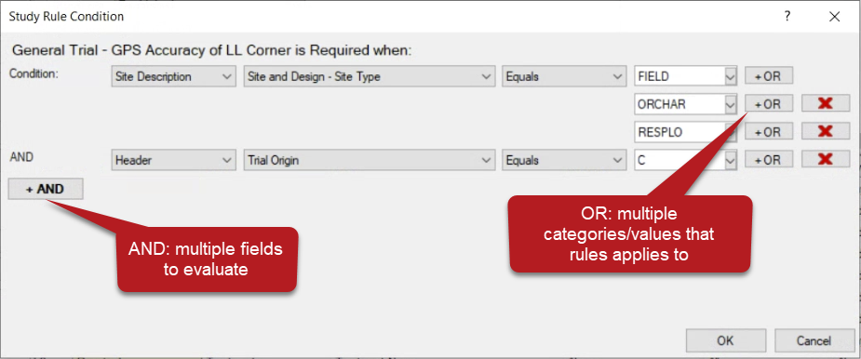
Conditional Rules
Condition can be based on multiple fields, or multiple values within single field
2 of 2
2022.7
Notes:
Contact GDM if you want to use this feature but are uncertain how to add the correct logic!
#W92

Slide 8
Site Description
ARM Powered by GDM Solutions

Slide 9
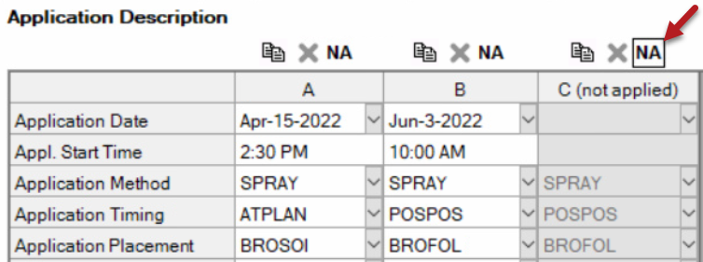
Application Not Applied
Identify an application that is not applied
Purpose: Retain a planned application code, but denote that it was not performed
Process: Toggle NA button above application
2022.2
Notes:
#W5

Slide 10
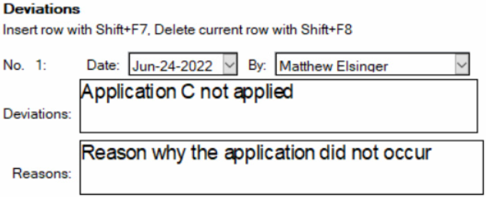
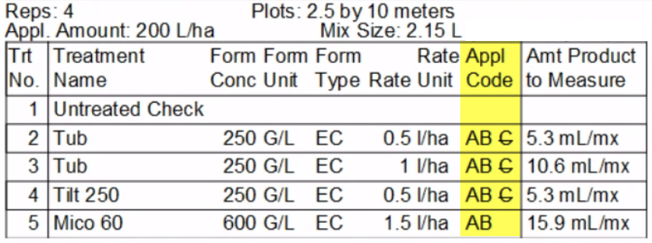
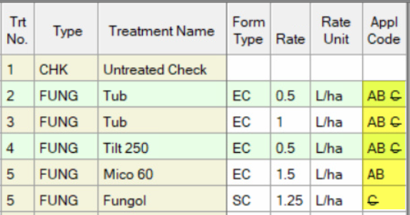
Application Not Applied
Impact:
Enter a deviation to explain circumstances
Not included in product calc's
'NA' applications display with strikethrough
Appl. Date field can be blank without failing validation if marked 'NA'
2022.2
Notes:
#W5

Slide 11
New Fields
Many new fields added to editors in Protocols and Trials
New Regulations tab with Harvest Destruction section
More columns in Trial Location table
Crop Description expanded in protocol
…and now separate from Pest Description too
See ARM 2022.5 Field Changes PDF for more details: https://gdmdata.com/media/documents/Change_logs/ARM_2022.5_Field_Changes.pdf
2022.5
Notes:
#W5

Slide 12
Repeating Sections
Empty record automatically added at end of repeating sections
Easier to add additional items without “Insert Repeating Section” command
Excludes Application, Crop, and Pest sections
2022.5
Notes:
#W5

Slide 13
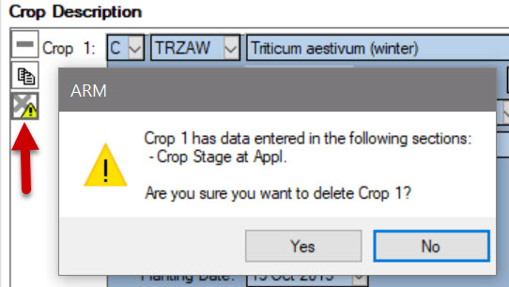
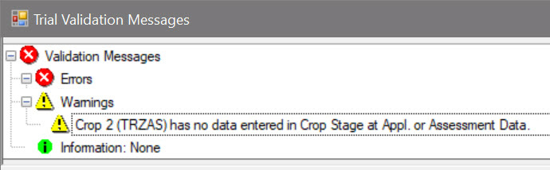
Crop/Pest in use
Verification for whether a crop/pest is used in the trial
"In use" if:
Information entered in Crop/Pest Stage at Appl sections, or
Referenced in an assessment column that has data
Warning when deleting crop/pest in use
Validation warning for when not in use
2022.2
Notes:
#W15

Slide 14
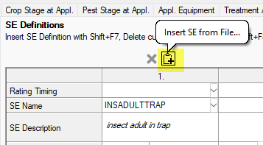
Insert SE from File
New shortcut button on SE Definitions: load an SE from your PC
Saves time after creating an SE from an existing assessment
After loading from file once, the SE is added to the SE Name Favorites list
2022.5
Notes:
#W5

Slide 15
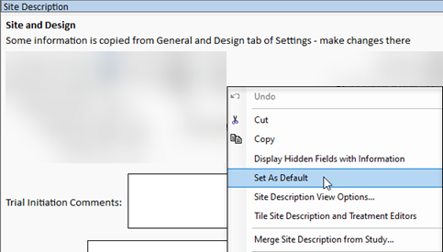
Set as Default
“Set as Default” can be used in rich text fields
Can include default instructions / required language for reports
2022.5
Notes:
#W5

Slide 16
Validation Lists
ARM Powered by GDM Solutions

Slide 17
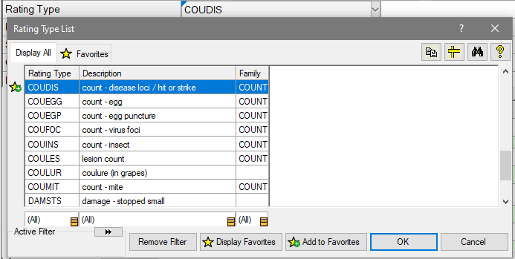
Validation Lists
Personal List is now Favorites
Favorites tab on list window (no more Display Personal/Master)
Master List is simply "Display All"
Shortcut buttons add or remove from Favorites
2022.0
Notes:
#12392

Slide 18
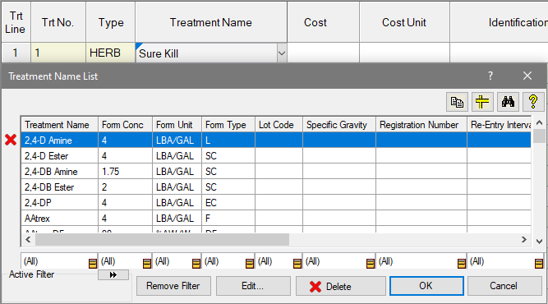
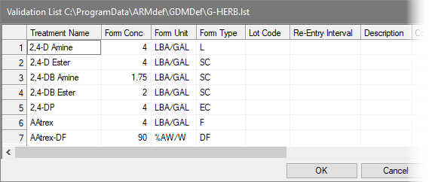
Validation Lists
"User-built" lists are improved
Shortcut "X" button to remove from the list
Open list in "edit" mode to adjust existing items
2022.0
Notes:
#12392

Slide 19
Assessment Data
ARM Powered by GDM Solutions

Slide 20
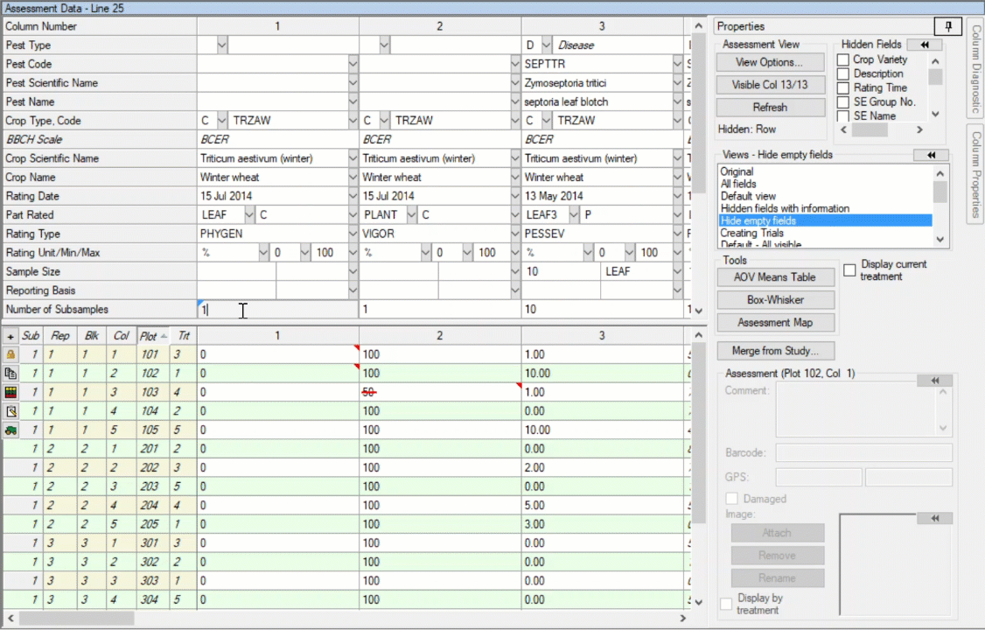
Assessment Image
New dialog for previewing and zooming assessment images
Improves performance for high-resolution photos
Workflow improved for using image to review or take ratings
2022.2
Notes:
#12478

Slide 21
Data Review
ARM Powered by GDM Solutions

Slide 22
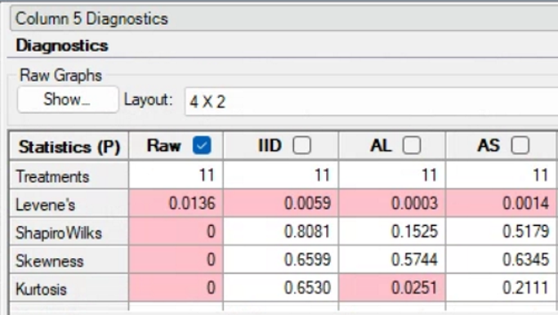
Column Diagnostics
Now highlights values that indicate a failure of data to meet AOV assumptions
P-values < 0.05 imply failure of data to meet tested assumption
2022.5
Notes:
#W5

Slide 23
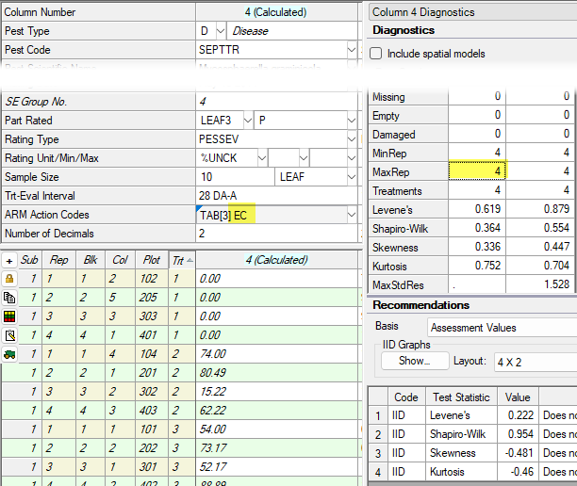
Column Diagnostics
Recognizes “selected treatments” Action Codes (EC, ETn)
Recommended actions now calculated after excluding the data
2022.5
Notes:
#W5

Slide 24
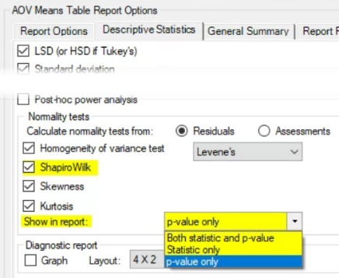
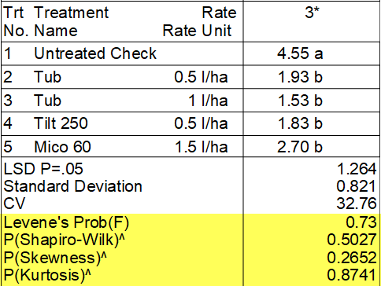
Normality Tests
Include all info used on Column Diagnostics in AOV report
Added Shapiro-Wilk test to report
Choose how statistical tests are reported
Test statistic, p-value, or both
2022.5
Notes:
#W5

Slide 25
Trial Signature
ARM Powered by GDM Solutions
Notes:
Present changes to signature behavior first,
And then let's introduce the study rule next (Since not all the changes apply ONLY for the rule)

Slide 26
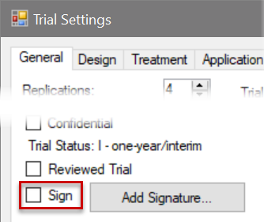
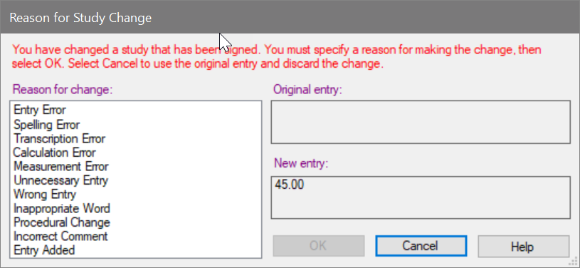
Trial Signature
Updates to the new Trial Signature feature:
Trial can be signed at any trial status (previously only for 'Final')
Signing a trial with status = Final (or later) starts an Audit Trail
All further changes are logged and prompted to provide a reason
2022.2
Notes:
#12461
Can set status < Final to turn off Audit trail
Audit trail included on the Signature page when applicable

Slide 27
Trial Signature
New study rule to require a signature at particular Trial Status
Field determines what status triggers rule
Condition determines who needs to sign
ARM prompts for signature when trial status is set (if validation passes)
2022.2
Notes:
#12461

Slide 28
Validation
ARM Powered by GDM Solutions

Slide 29
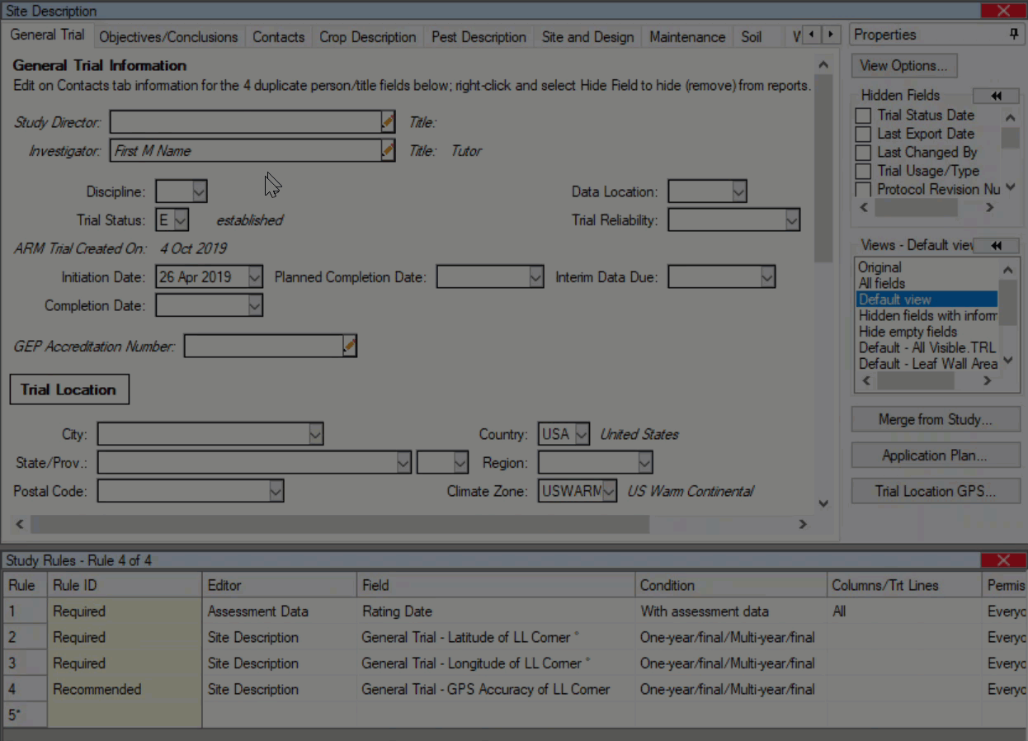
Trial Status
Validation is performed automatically when Trial Status is changed
Purpose: Study rules may become active with a different Status
Impact: Resolve validation issues before adding your signature to trial (or printing, sending, etc.)
2022.2
Notes:
(Related to Trial Signature changes, but also wanted to note its impact across other situations, not just signatures)
#12462

Slide 30
Print Reports
ARM Powered by GDM Solutions

Slide 31
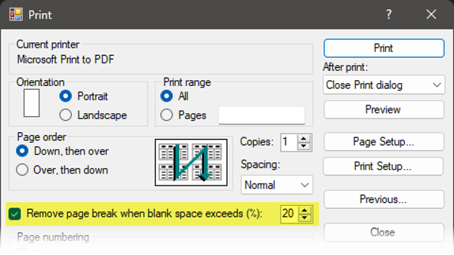
Summary Reports
Summary reports now always start on a new page in report
Summary reports = AOV Means, Assessment Data Summary, etc.
Select ‘Remove page break…’ to combine report sections on same page when there is room
Summary reports take up most of a page, so do not fit well if combined with other reports
2022.7
Notes:
#W199

Slide 32
Profile
ARM Powered by GDM Solutions

Slide 33
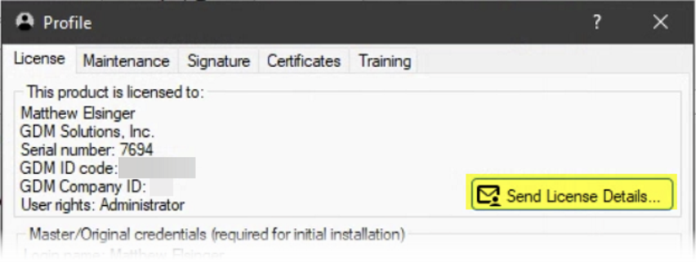
Send License Details
New ‘Send License Details’ button
Find it on the Profile and Request Customization dialogs
Share ARM license details in an email
2022.7
Notes:
#W177

Slide 34
Multi-factor Designs
ARM Powered by GDM Solutions

Slide 35
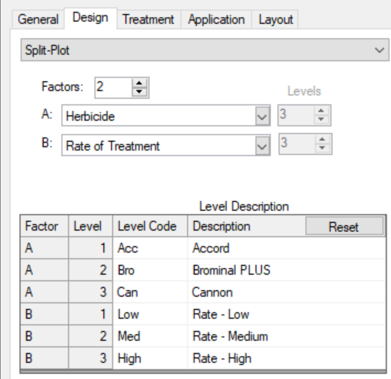
Multi-factor studies
Level Description added to Settings dialog
Same information on the Trial Map dialog
Now available in a protocol, too!
2022.0
Notes:
#12394

Slide 36
Treatments
ARM Powered by GDM Solutions

Slide 37
Validation updates
Added support for Biological Entity Dispensers as treatments
Treatment Type: BIOENT
Formulation Units: BIOEN/D (biological entities per dispenser)
Formulation Type: BD (biological entity dispenser)
Rate Units: dispensers per area or per number of plants
D/A, D/ha, D/1000 FT2, D/100 m2, D/1000 plants, D/10000 m2 LWA
2022.0
Notes:
#12472

Slide 38
Data Analysis
ARM Powered by GDM Solutions

Slide 39
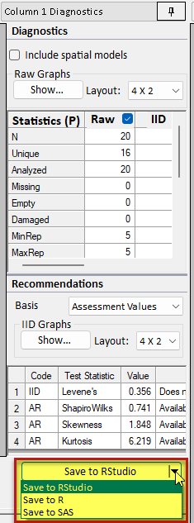
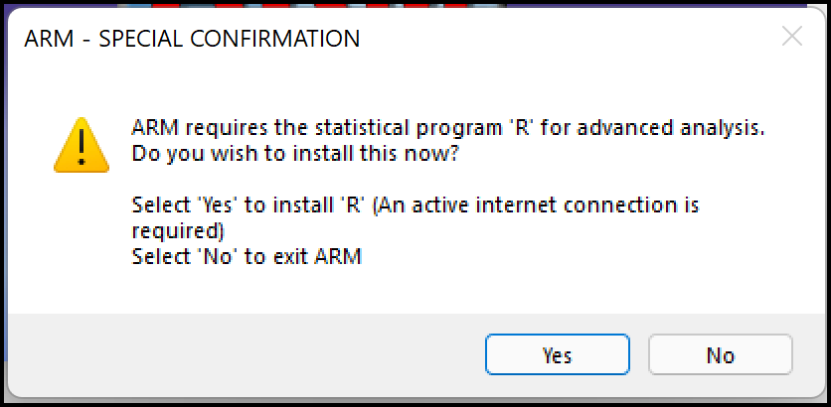
R software update
ARM now supports R versions 4.2.0 and newer
No additional installation/update needed at this time
R is used behind-the-scenes for analysis, reporting
R users – export Column Diagnostics script to R:
Previously would give an error if R version was too new.
2022.2
Notes:
#W5

Slide 40
ARM Mobile
ARM Powered by GDM Solutions

Slide 41
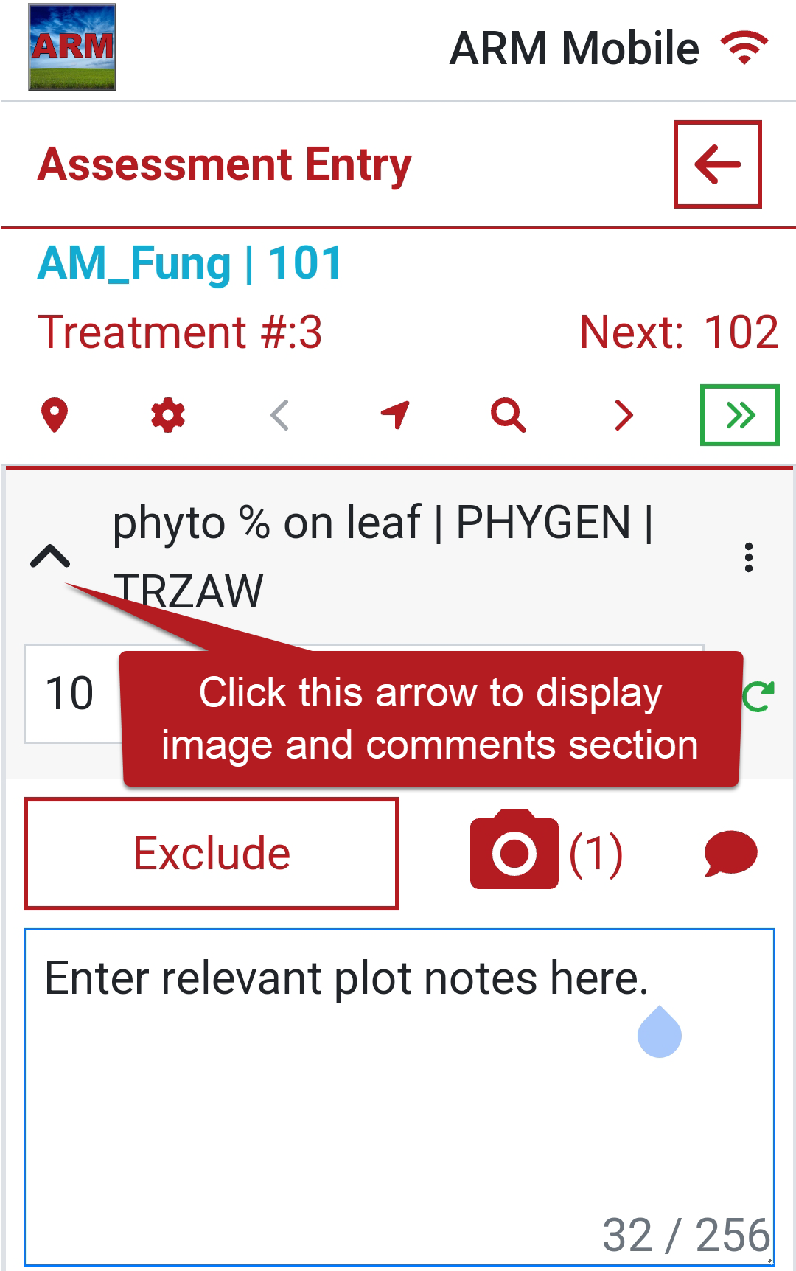
Export images
Export images from ARM Mobile with or without data
Purpose: Allows user to export images, comments, or GPS during or after assessment export.
Example: One researcher can enter only data, another can take plot pictures. Both can export the same assessment data column – images will import “on top of” data.
2022.2
Notes:
#W5

