Slide 1
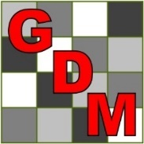
ARM Tips & Techniques
20th Annual at NAICC
Powered by GDM
Notes:
Introductions of personnel within the room.
Level of experience within the room.
Never used ARM before
Less than a year
1 year or more
2 years or more
Up to 5 years
Up to 10 years
10 years or more
Who is a returning client from last years presentation?
SD cards – ARM has an integrated backup feature which if used correctly will utilize a backup device which is separate from the hard drive which ARM is installed on. If you do not have a backup established on the device today, we are willing to provide one as a preferred method to backup your data. We do strongly recommend having a backup.

Slide 2
Our Mission
“Provide the research community technology to improve efficiency and accelerate innovation”
Notes:
We exist because of companies like you.
We invest in ARM to make sure that we keep a competitive advantage in the market place.
We do this by providing innovative products to facilitate efficient, effective and accurate research.
How,
ARM alone – adopted industry standards
ST – ability to summarize complex data across locations
TDCx – ability to efficiently take notes within the field knowing that ARM had the ability to name and store pictures/plot and data review tools
ATD – Enables a structured database to securely store all relevant research data for trial

Slide 3
ARM Software is Trusted by Over 10,000 Researchers and Scientists Worldwide
In Over 100 Countries
The Proven Software of Choice for 12
Notes:
And growing!!
We see increasing demand within Asia and South America.
Along with increased momentum with ST especially within Europe.
Also, a large push towards ATD as of late. I believe with the mergers, companies are understanding the value of real-time data and the ability to easily share results.

Slide 4
Use ARM for all stages of an experiment.
To plan and create protocols, to randomize and manage trials, to analyze data and report the results.
Notes:
Our researchers use are for all stages.
This is a software solution for the research community.

Slide 5
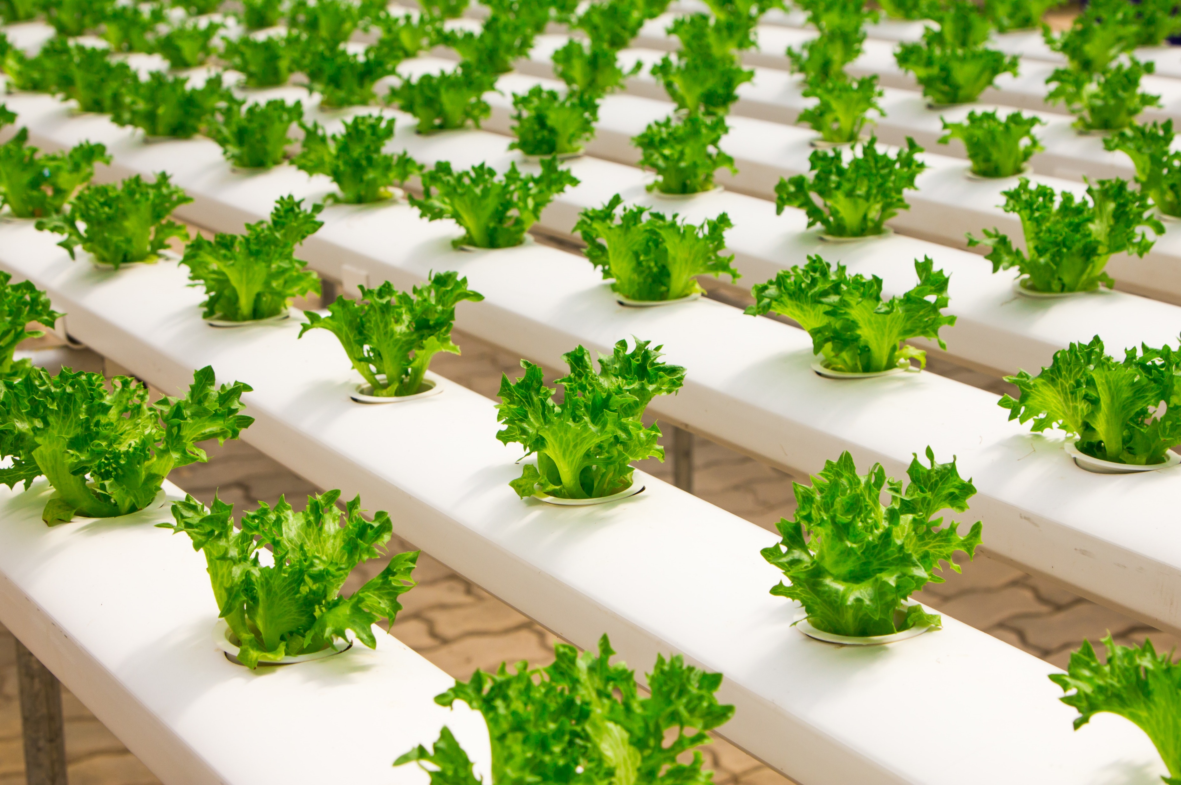
ARM software provides a defined structure to enter information consistently, with master list dictionaries to standardize vocabulary, and has tools for every step of an experiment.
Notes:
It is imperative that companies understand these features to benefit from the defined structure to aid with research activities.

Slide 6
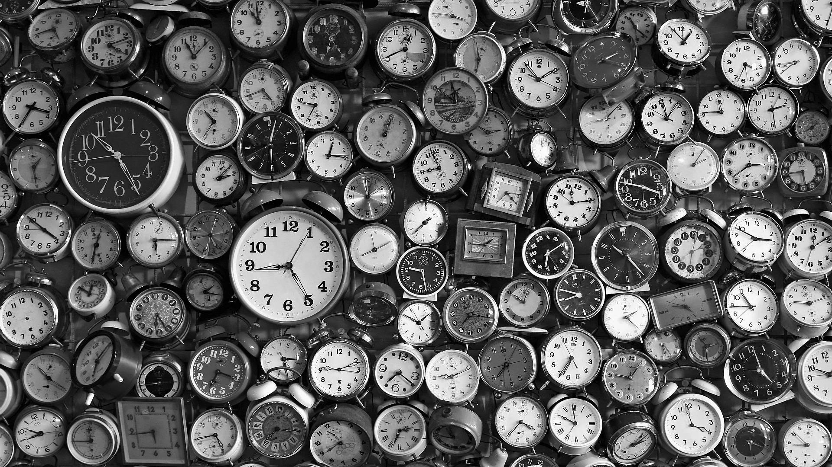
The Last Year in Review
Notes:
I would like to show of what GDM has accomplished this past year.

Slide 7
ARM the Industry Standard
The top 12 Agro-Chemical companies now depend on ARM Software worldwide.
Notes:
With the Dow/DuPont merger, DuPont personnel have started the adoption of ARM moving us from the Top 9 Agro-Chemical companies to the Top 12. I believe the next movement would need to be within the Chinese market of which we don't have a huge interest in.

Slide 8
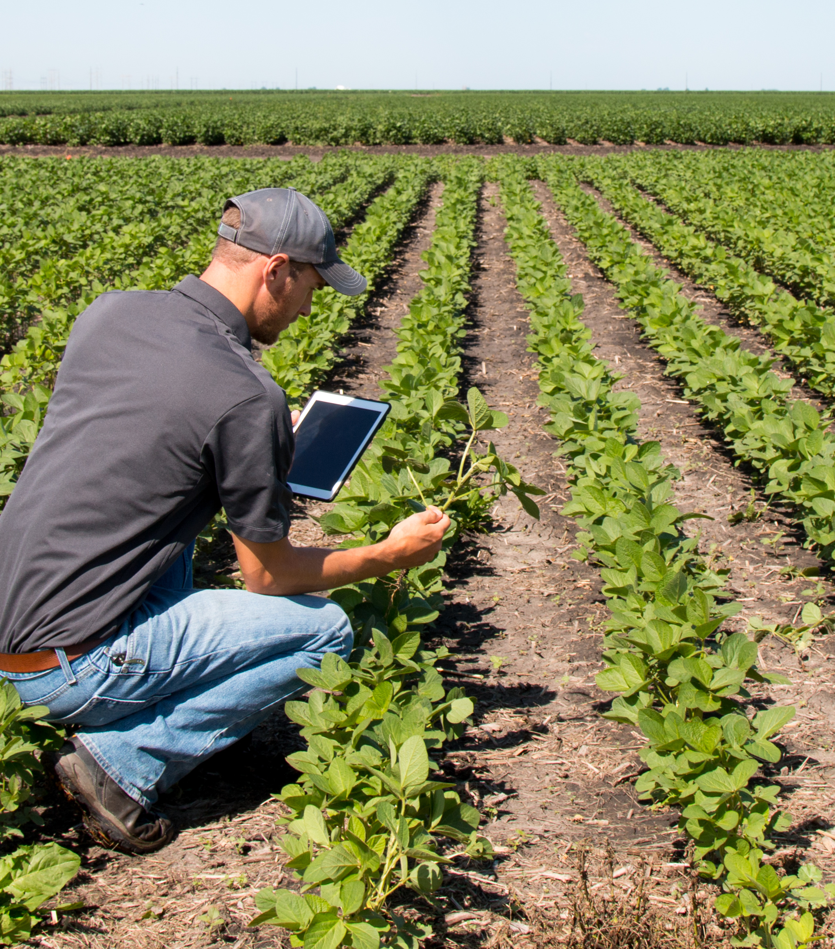
Field License Bundle
This bundle brings ARM to the field to help improve efficiency and accuracy.
Notes:
Reap the benefits of ARM in the field!!
Take ARM to the field to quickly enter data ONE-TIME and have the results at your fingertips. Best time to catch a data error is at the time of entry. Utilize the action codes to stabilize data entry along with the Data Review tab to analyze data prior to leaving the field.
Be sure to validate the trial before leaving!

Slide 9
Leaf Wall Area
Software solution for an industry specific challenge. ARM facilitates the research techniques for future regulation of product applications.
Notes:
Developed specifically for the AgroChemical industry!
This has been a hot topic, as there is a need to accurately document applications. We have added several fields in relation to application details.

Slide 10
Weather Data Import
Collaboration with ClearAg (Iteris) to build a new feature that allows you to import weather data.
ClearAg offers specific information by utilizing meteorology, agronomy, land surface modeling and crop production at specific GPS coordinates.
Notes:
New tool to easily link aggregate weather data right to the ARM trial. Document the weather prior to the first activity of a trial, current conditions at the time of activity, along with weather after trial completion.

Slide 11
Marketing & Support
We hired a full-time sales and marketing associate to focus on our client communications.
Notes:
Product Pulse is here. Quarterly report designed to provide guidance of new features of ARM. So that, you are not using ARM for 6 years not knowing a feature exists.
Please speak up with new feature requests! We listen.

Slide 12
The Year Ahead
In Over 100 Countries
The Proven Software of Choice for 12

Slide 13
Training Initiatives
Continue to expand our tools and resources to make it easier for our clients.
- Tutorials
- Coaching Events
- Webinars

Slide 14
Product Release
Work as a team to ensure every client is aware of the new features and how to use them to make their work more efficient.
Notes:
Tutorial videos are key.

Slide 15
Precision Ag
Work closely with South Dakota State University to provide support with development and implementation.
Correlation of known variability
UAV data analysis
Notes:
Tutorial videos are key.

Slide 16
Client Driven Development
Working closely with our clients to implement additional features and intuitive reporting.
Providing new features throughout the year.
Notes:
We continuously work for the AgroChemical industry making ARM better and to better fit the needs of researchers world-wide. However, we need out client opinions!

Slide 17
ARM improves efficiency, increases accuracy, and
promotes better quality of results.

Slide 18
ARM 2019 Enhancements
Notes:
Enhancements made in ARM versions after initial 2018 release (versions 2018.2 through 2019.1)

Slide 19
Repeated Measures
ARM Powered by GDM Solutions

Slide 20
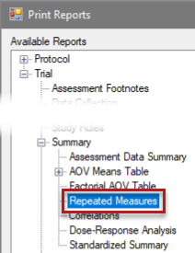
Repeated Measures
Analyze repeated assessments across time
Enhancement
Powerful statistical analysis which enable the control of factors which cause variability between treatments over time.
Provides analysis of treatment means over time to determine if there is an overall time effect on the treatments performance.
Notes:
Suppose strawberry varieties are being tested for yield, and that strawberries are harvested repeatedly at 1 week intervals over 8 weeks. If net productivity is important, then the cumulative yield over 8 weeks might be a sufficient derived measure. Varieties could be compared using a standard anova of the total yield.
However, if varieties are to be distinguished as early- or late-bearing, then a repeated measures analysis to identify peak harvest intervals would be appropriate.
#8655

Slide 21
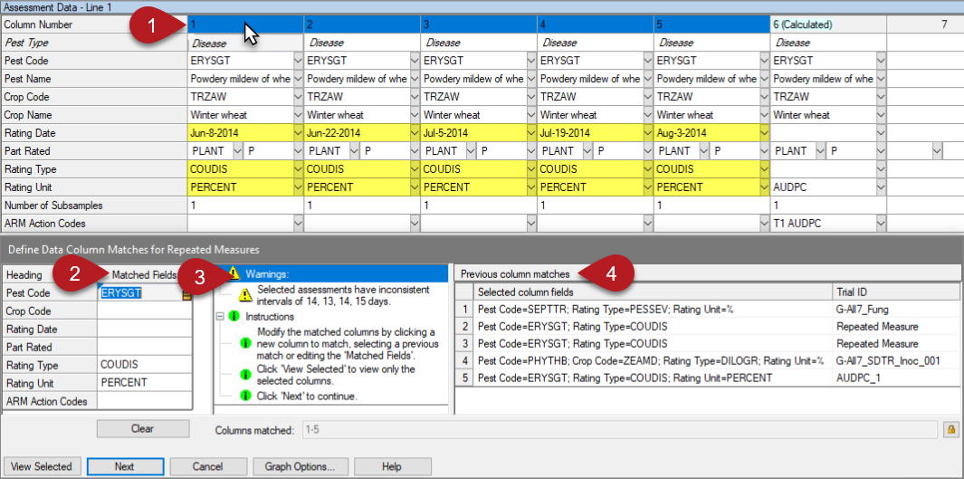
Repeated Measures
Define assessments for analysis:
Select a column to find potential repeated assessments.
ARM proposes fields to match other columns.
Diagnose issues with column selection.
Or load from history of column matches.
Notes:
#8655

Slide 22
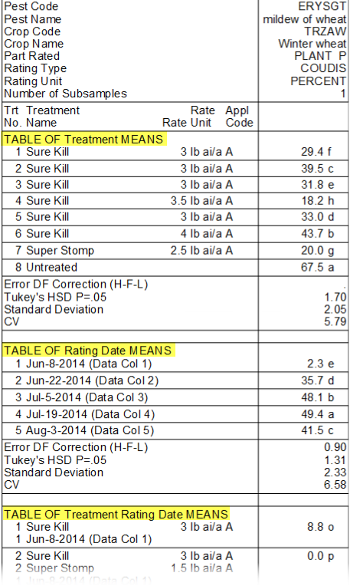
Repeated Measures
Means and comparison letters for:
Treatments Rating Dates
Treatment x Rating Date interaction
Apply correction to adjust for correlation (H-F-L or G-G)
Repeated Measures AOV table
22
Notes:
AUDPC 1
#8655

Slide 23
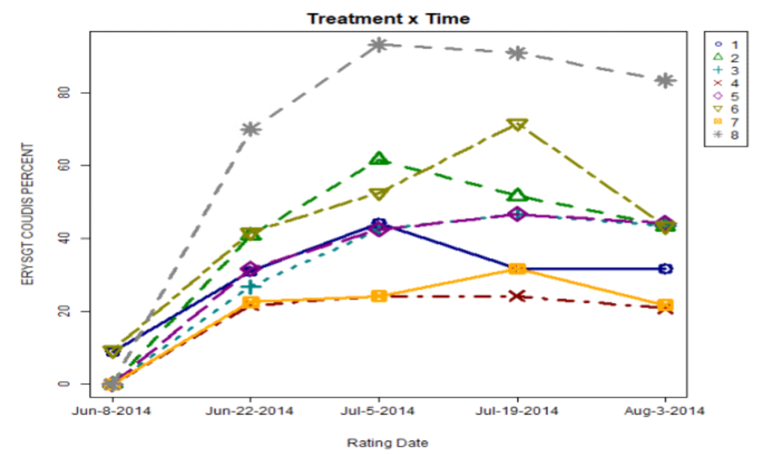
Repeated Measures
Treatment x Time Graph
Plot treatment means over time.
Visually identify treatment interaction across assessment dates.
Notes:
#8655

Slide 24
Study Review
ARM Powered by GDM Solutions

Slide 25
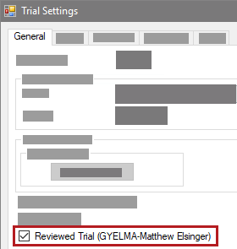
Review Study
Mark a trial as Reviewed
Track whether a trial has been reviewed
Identifies who marked as reviewed
Trial Settings > General tab
'Trial Reviewed' action is automatically logged in Notes tab of Site Description
Checkbox is cleared when any change is made to data in the trial
Notes:
#10492

Slide 26
Review Study
Create a review group
'Review' study rule defines who is allowed to mark a trial as reviewed
Condition field defines who to include in the group:
just protocol or trial owner(s)
everyone in my company
Anyone (i.e. no group)
Example: Sponsor wants to ensure the study is reviewed internally. Contractor can still create their own separate review group to review before sending back to the sponsor by adding another 'Review' rule for their company.
Notes:
#10492

Slide 27
Study Rules
ARM Powered by GDM Solutions

Slide 28
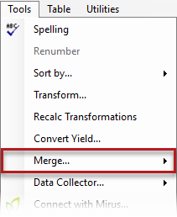
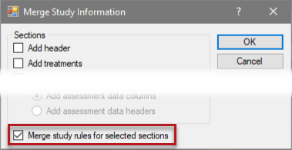
Study Rules
Merge Study Information
Easily copy information from study to study.
Replaces “Save As” function.
Enhancement
Choose to not merge study rules if the study is originated by your company.
Offers new flexibility for internal researchers.
Feature in action
Notes:
Create a new Protocol >
Why?: Replaces the "Save As" (Matt helps with the issues resulting from Save As). Tailors the information requested to duplicate from previous trial/protocol. Time efficiency, less chance of errors.
What is new with merge?
If I am merging information from a study that I did not create, I do not have the option to decline the study rules. The option will be grayed out. This eliminates researchers from merging all information from a protocol/trial and alleviating the requirements of the study rules from the protocol owner.
Option also allows the owner of the protocol/trial data of interest to decide whether or not to bring in the Study rules for the selected sections. This gives flexibility of researchers within the same company to use the merge feature.
#10522

Slide 29
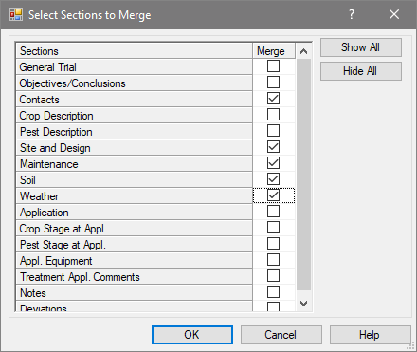
Merge Study Rules
Enhancement
Limit study rules merged to only selected protocol/site description sections.
Notes:
When merging specific sections of a protocol/trial (protocol/site descriptions) the study rules associated with the specific sections that were selected will only merge.
Flexibility with selecting rules associated with specific sections within the Protocol/Site Description editor.
#10522

Slide 30
Validation
Always Validate Studies
Validation ensures all protocol criteria has been met.
Enhancement
Validation messages now list the study rule number that triggered the error or warning message.
Feature in action
Notes:
During the "Send To function" ARM will now guide the researcher to the specific study rules not satisfied. While clicking the "Validate" shortcut menu icon, it states the study rule which is not satisfied.
Researcher now has the ability to easily find the affected study rules quickly to either alter or remove the rule.
Study rules are set to help alleviate embarrassment aids with attention to detail during the busy research season. Brings awareness to what is missing. Study rules add value to the researcher.
#10446

Slide 31
Rule Set
Rule Set Name Identification
Identifies/Verification of the correct rule set used within study.
Enhancement
The name of the loaded rule set now displays in the editor heading when a rule is selected within the table.
Feature in action
Notes:
How does this benefit our clients? Gives the awareness of how the rule has been introduced.
May come to light after a validation fails, maybe loaded the wrong set? Maybe find documentation as to why that is important within that set.
#10451

Slide 32
Tools
ARM Powered by GDM Solutions

Slide 33
Tools: Merge
Existing blank treatments are automatically removed when performing a merge with another study.
<- Before and After ->
Notes:
Very annoying to users when they would create a new protocol and want to bring in the treatments through the use of the "Merge" feature, but would leave a blank treatment #1 and then would have to delete the treatment and renumber the treatments.
Create a new protocol.
Merge from Study, click add treatments, the empty treatment number one now is replaced.
#10261

Slide 34
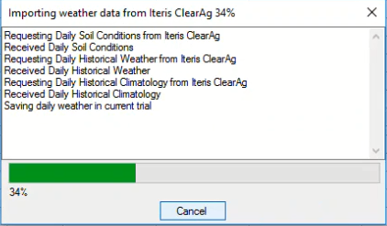
Tools: Import Weather
Progress bar added during Weather import
The weather is imported from outside the ARM software.
This ensures you know that progress is being made ☺.
Notes:
Open a trial and import weather data.
This is a small enhancement for those using weather and felt uncomfortable when importing a large number of days of weather. This states what is occurring within ARM. What if the connection is poor? Hotels?
This gives assurance that the software is continuing to work and making progress.
#10281

Slide 35
Study Settings
ARM Powered by GDM Solutions

Slide 36
Trial Time Zone
Why is a specific time zone needed?
Ensure the alignment of the trial location in relation to time zone to external data providers.
New Weather API will align location specific weather for a particular time, such as per application.
Trial Settings > General tab
Notes:
Needed to satisfy the weather import to align specific time documentation for applications.
Go to Settings > General tab to set.
Trial location time zone added to Settings > General tab. Also connects with Weather Import dialog.
If weather data is brought in at the time of application, we needed to align the time zones to the API weather data.
#10296

Slide 37
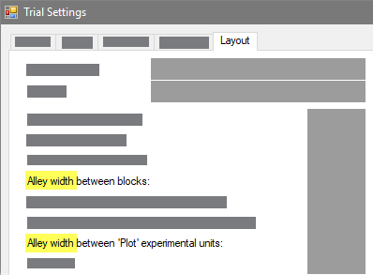
Layout Options
Clarified 'buffer' option text
Changed to 'Alley width' - a more commonly used term
Previously called 'Buffer' between blocks or plots
Protocol/Trial Settings > Layout tab
Notes:
Previously the phrasing was confusing, and nobody refers to that space in the field as a "buffer". The term "alley" is much more widely used.
#10663

Slide 38
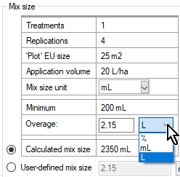
New Options - Liters
Liters as an Overage Option
Clients may have equipment that requires a very large amount of overage. Instead of using ML’s (1000's), you now have the option of Liters. Example: 2150ML vs, 2.15L.
Can be entered in the Settings > Application tab or, Appl. Equipment > Mix Overage, Unit or, Application Plan.
Notes:
The "L" was always an option for the "Mix size unit" but was not available for the "Overage". Now is an option for the "Overage". Some equipment requires a fixed size of 2 liters prior to development, this would need to be listed as 2000 ML, now can display as 2 L.
#10459

Slide 39
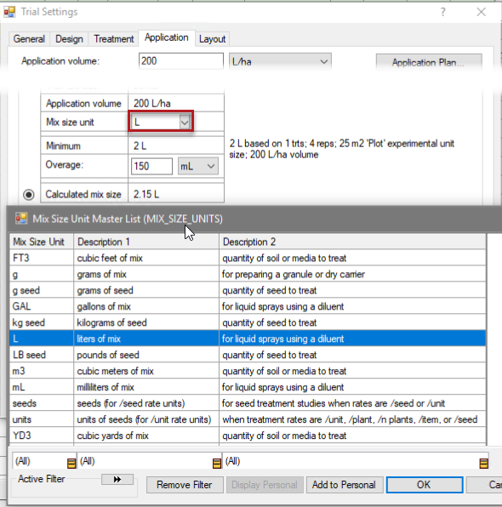
Mix Size Units
Enhancement
Brings consistency to the unit names whether you are in the treatments editor, settings, or application plan.
Settings > Application tab
Appl. Equipment > Mix Overage, Unit or, Application Plan
Notes:
Why? This brings consistency to the choice of unit whether you are in the Treatments editor
The Units for Mix Size unit were only a combo box, now is a Master list.
Moved from "liters" to "L" to add consistency of presenting units.
#10180

Slide 40
Site Description
ARM Powered by GDM Solutions

Slide 41
Track Trial Progress*
*Coming in ARM 2019.1
Why document trial progress?
Requested by sponsors.
Provides visibility and credibility to timely data entry.
Added new fields to track status and progress throughout the season.
Notes:
These are read only.
After adding a Crop/Pest then it will add it after selecting either a Crop/Pest. This will disappear if the repeating crop/pest section is deleted. The date will also update if there is a change to either the crop/pest.
Implemented at the request of sponsors, to see when the trialist entered relevant information. This is documentation so that sponsors understand when data has been entered and have the ability to understand those CRO's who enter timely data throughout the season. Sponsors prefer data to be entered at the time so that accuracy is achieved as research is very expensive.
#10407

Slide 42
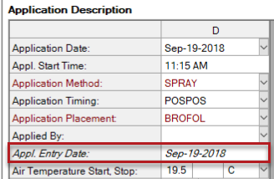
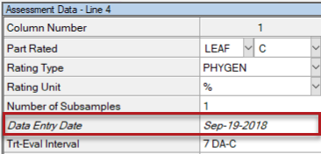
Track Trial Progress*
*Coming in ARM 2019.1
Additional new fields to track status and progress throughout the season.
Application tab > Appl. Entry Date
Assessment Header > Data Entry Date
Notes:
Same discussion as previous slide but now applies to the Application tab and Assessment data columns.
#10407

Slide 43
Protocol Instructions
Support Rich-Text Formatting
Preserves the format from the original protocol through to the Trial.
Notes:
Preserves the format of the information presented from the original protocol (keeps the look). Have the ability to look more professional during the printing and presentation of the final results of the trial.
Also, changed the name of the description tab to "Protocol Instructions" from "Protocol Comments"
#10375

Slide 44
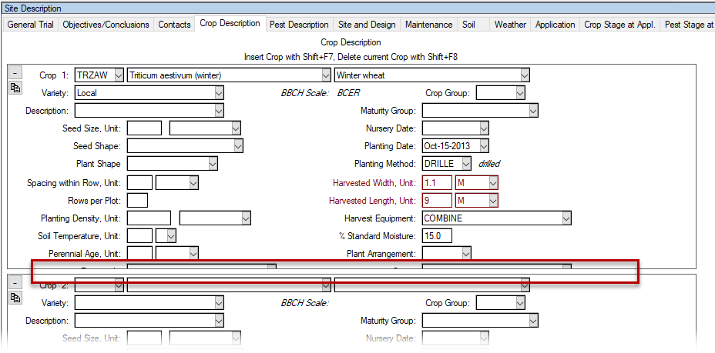
Collapsible Repeating Sections
Fixed:
Repeating section panels now resize after displaying hidden fields.
Notes:
Why? Fixing a bug.
The panel was not resizing after displaying the hidden fields. Previously, had to collapse and resize to access the additional fields.
#10455

Slide 45
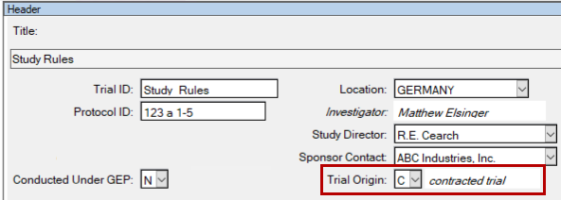
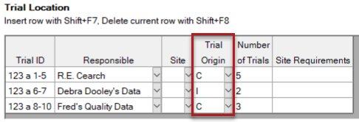
Trial Origin*
*Coming in ARM 2019.1
Why track the trial origin?
Helps answer budget questions.
Valuable to the R&D division.
ID’s in-house, contracted or by a public institution trials.
Header editor > Trial Origin or,
Trial Establishment Guidelines > Trial location Table
Notes:
Why? This is valuable information to an R & D division as they can assess whether the meaningful trials are in-house, contracted or by a public institution. Research division use this for budgeting purposes to help maximize the value to the research dollars spent.
Go to Header section.
Or, go to a Protocol > Trial Location table to see the option.
#10333

Slide 46
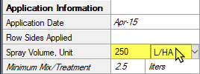
Application Equipment and Plan
Auto-Fill default settings for application planning fields.
Intuitive way of using Settings set to default and fill out the plan.
Enhancement
Auto-fills with default entries when clicking in a blank field for mix size, mix overage and spray volumes.
Notes:
Why? This is an intuitive way to enter data into the Application plan if the Settings values aligns with how they performed the application at that timing. Key is to use the Settings dialog as the default
Clear out the values for any value within the Settings Application tab. Then go to the application plan and click within the values and it will auto fill with the value defined within Settings.
#10426

Slide 47
Assessment Data
ARM Powered by GDM Solutions

Slide 48
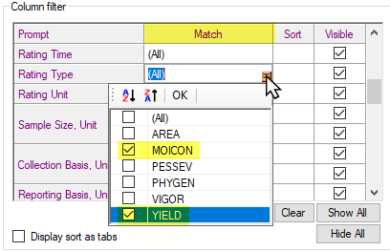
View Options
Show more than one type of entry when matching on a field.
How does it work?
Select multiple items for the “Match” column
Filter.
Notes:
Previously was a combo box which limited the ability to show more than one type of entry for a specific field.
#10172

Slide 49
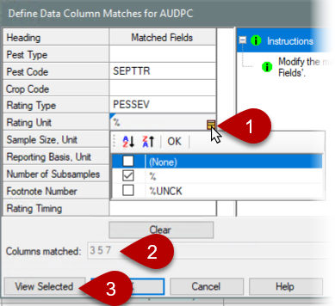
AUDPC Transformation
Enhancement during AUDPC
Allows selecting multiple values for match fields.
Lists columns currently matched.
View only selected/matched columns on the assessment data editor.
Where is this feature?
Tools > Transform, select AUDPC
Notes:
Why? Let's you recover data during analysis without the strict requirement of having the values same.
Go to Tools > Transform, select AUDPC
#10200

Slide 50
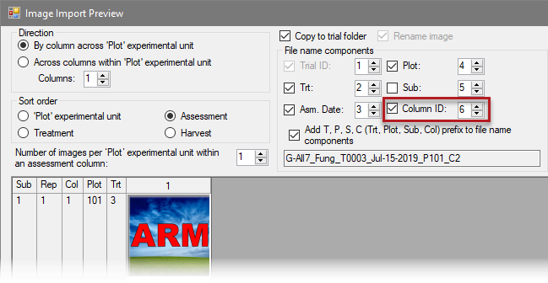
Plot Pictures
Include Column ID in assessment image file name
Helpful when attaching images for multiple assessments taken on the same day
Where is this feature?
Assessment data editor > Properties Panel > Attach
Notes:
Previously if attaching images to multiple columns rated on the same day, then the file names would be identical.
#10655

Slide 51
Tablet Data Collector (TDCx)

Slide 52
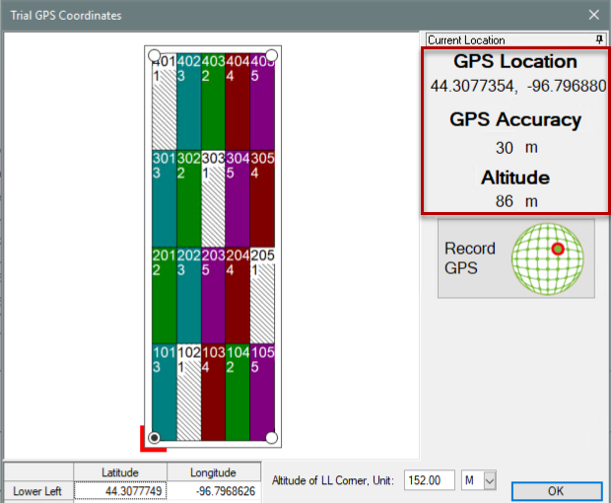
Record GPS
Display the current position in real-time
Researchers now can determine the accuracy of the GPS device while documenting coordinates.
TDCx will display: GPS coordinates, accuracy and altitude.
Where is this feature?
Choose “Tablet Read GPS Editor”
Notes:
Why? Now the researcher has the ability to determine the accuracy of the GPS device while documenting the coordinates.
Display by choosing the Tablet Read GPS editor.
#10238

Slide 53
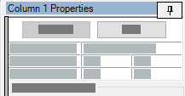
Properties Panel
Increased size of Pin button
Previously was hard to click on the small Pin button to unlock a Properties panel when using a stylus (or finger) on a tablet
Notes:
Especially tough on the Mesa2 tablets. On TDC panels are automatically locked when opened, but the tiny button made it hard to close the panel then.
#10495

Slide 54
ARM Migration
ARM Powered by GDM Solutions

Slide 55
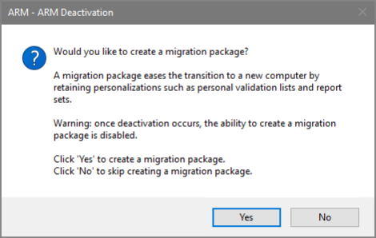
Migrate Settings*
*Coming in ARM 2019.1
Copy settings when moving to a new PC
Copy personal lists, report sets, ARM settings to new computer
What's new?
Prompt to create package before deactivating the old PC.
Notes:
#10270

Slide 56
Reports
ARM Powered by GDM Solutions

Slide 57
Spray Seeding Plan
Why minimum mix size calculator?
This helps determine the minimum mix needed.
Proactively plan for your trial with this calculation.
Enhancement
ARM reports the bare minimum mix size needed to cover the area of all 4 reps.
Notes:
Go to Print > Spray Seeding Plan Report
This was removed in the initial release of 2018 because the spray/seeding plan report now stated the overage.
ARM calculates the area of the plot and the spray volume the minimum mix size is the bare minimum needed to cover the area of all 4 reps. We had heard many complaints about the omission of the "minimum" mix needed.
Phone was ringing off the hook! – we listened to our clients.
Having both of these numbers on the spray sheet prevents researchers from making mistakes in the field.
Click on the tool from several areas to calculate the mix needed for the application.
We have added the calculated minimum mix for one treatment, which is an automatic calculation that ARM will store within the application tab. This is a read-only field which is then compared to the mix requested by the researcher. Based on the application volume and treated plot area. Intended as a reference point. We have an explicit Overage field for the quantity or volume of mix that is needed to fill the lines on the sprayer between the mix tank and the delivery nozzle. ARM can then provide a more exact amount of quantity needed for the amount of mix to cover the treatment. So that now a smaller mix can be created.
Built in a series of logical indicators within ARM to provide documentation
If there was an application volume of 250 L / hectar and we need 2. 5 L for the treated area. Then with 150 ML for overage. So that we would need 2.65 L of mix to
#10321

Slide 58
SE Definitions
ARM Powered by GDM Solutions

Slide 59
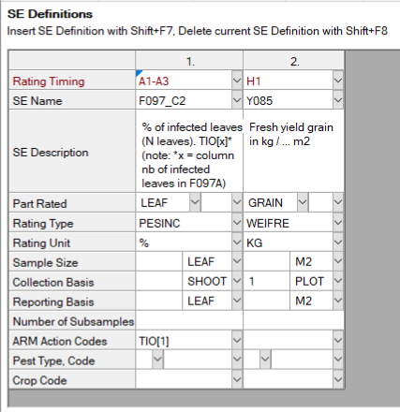
SE Definitions*
*Coming in ARM 2019.1
Plan and define standard evaluations (SEs) and tasks to use in the study
Simpler than importing SEs from file into assessment data editor
Use Tools > 'Build Header, Tasks' to create the SEs and tasks defined in this tab
Multiple rating timings create columns for each timing code
Two-column SE F097_C2 times 3 rating timings A1-A3 = 6 total data columns
Notes:
#10333

Slide 60
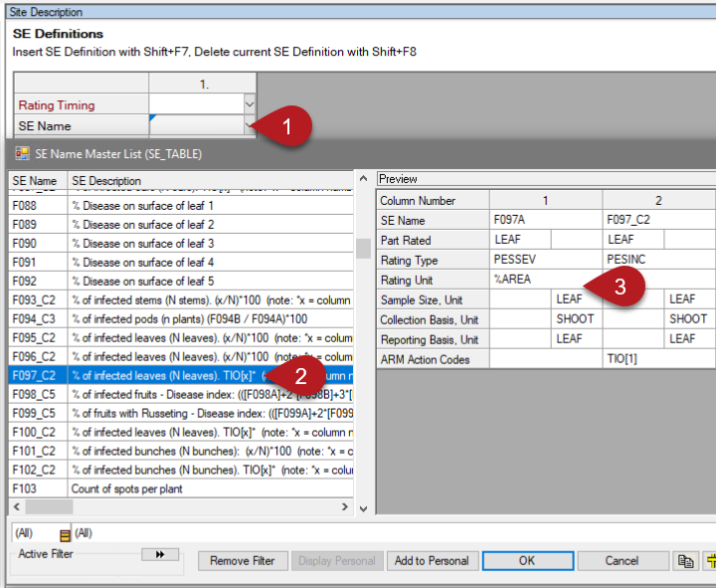
SE Definitions*
*Coming in ARM 2019.1
Display SE Name list
Select an SE, can search/filter descriptions
Preview assessment columns defined in SE
Can also define tasks on this tab to add to Schedule editor
60
Notes:
#10333

